Slide 1
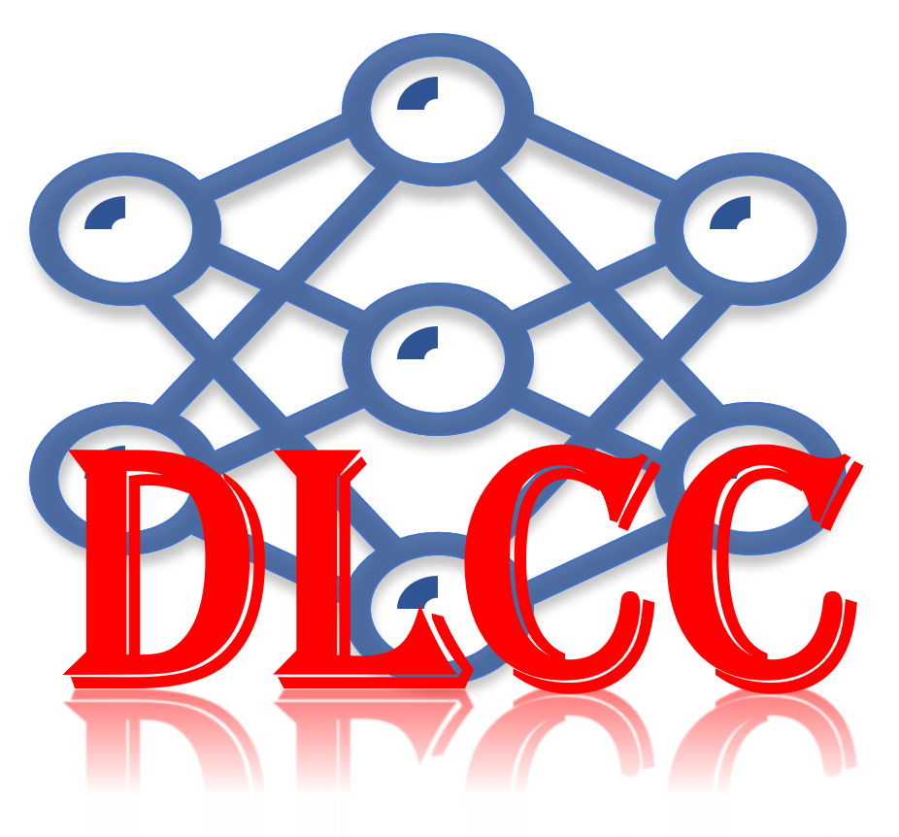
Deep Learning Crash Course
Hui Xue
Fall 2021
www.deeplearningcrashcourse.org

Slide 2
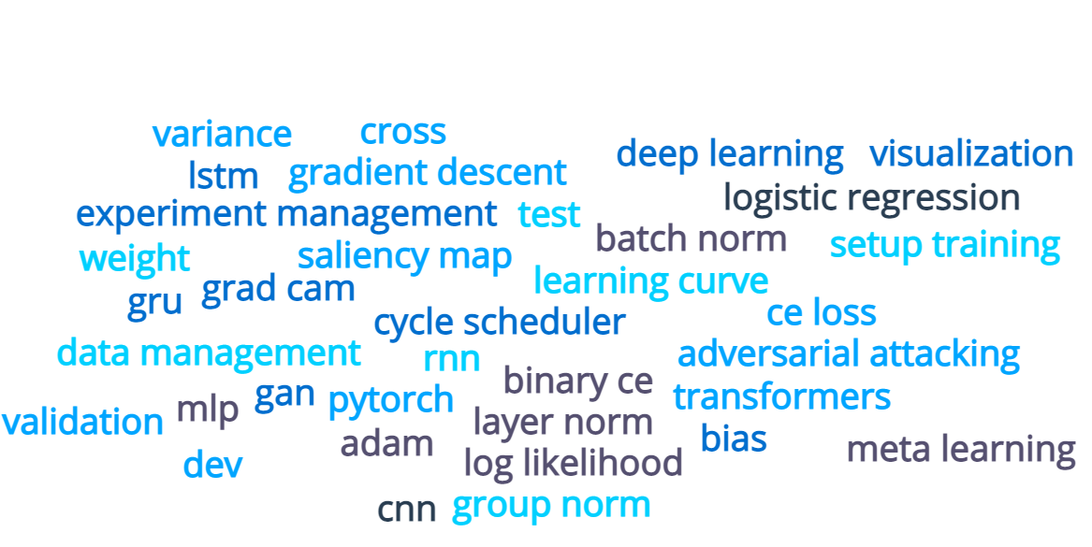
Closing remarks
Neural Network basics
Setup your training
CNN
RNN, transformer
GAN
Adversarial attacking
Visualization
Transfer learning, meta learning, contrastive learning
Data management, experiment management …

Slide 3
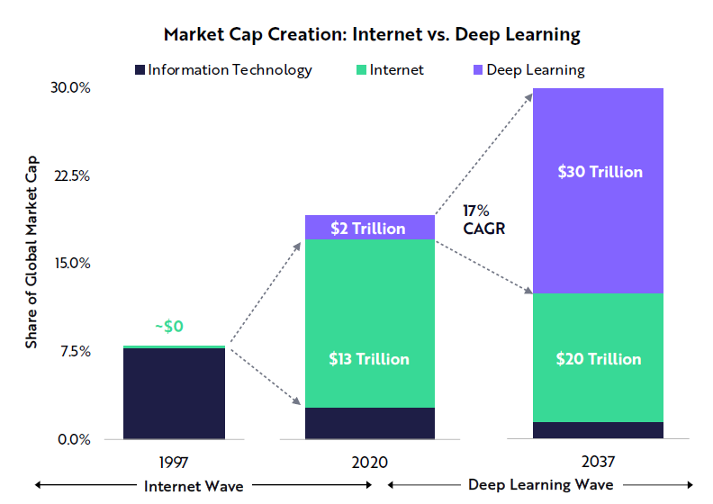
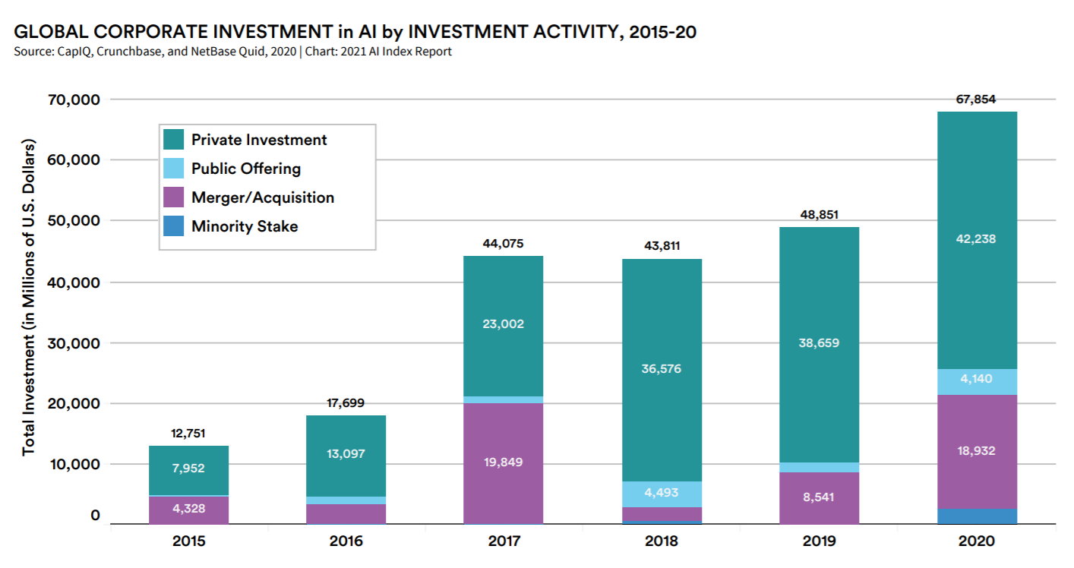
Big picture
According to ARK's research, deep learning will add $30 trillion to the global equity market capitalization during the next 15-20 years.t
-- Big Idea 2021, https://ark-invest.com/big-ideas-2021/
Chapter 3, Artificial Intelligence Index Report 2021

Slide 4
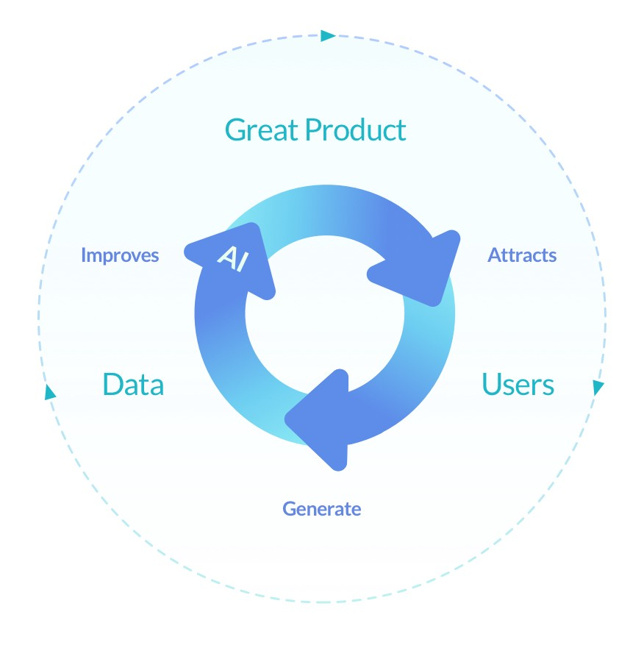
Model centric to Data centric
Model
Novel architecture, optimization, new loss func …
Data
curation, cleaning, versioning, validation, testing …
Deep Learning
Vicious circle of Deep Learning
https://www.youtube.com/watch?v=06-AZXmwHjo&t=1142s

Slide 5


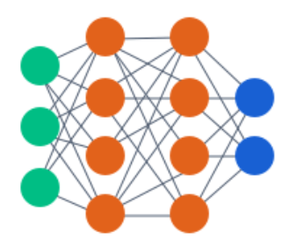


More focus on system/MLOps
Premise
predict
deploy
Further training,
with algorithm improvements
Find edge cases
Process buffered data
Initial dataset
Archived dataset
Better training dataset
Training
Model v1
Model v2
MLOps : hybrid team, ML pipeline, data versioning, testing, experiment management, monitoring model performance and data shift …
Start by making your training reproducible

Slide 6
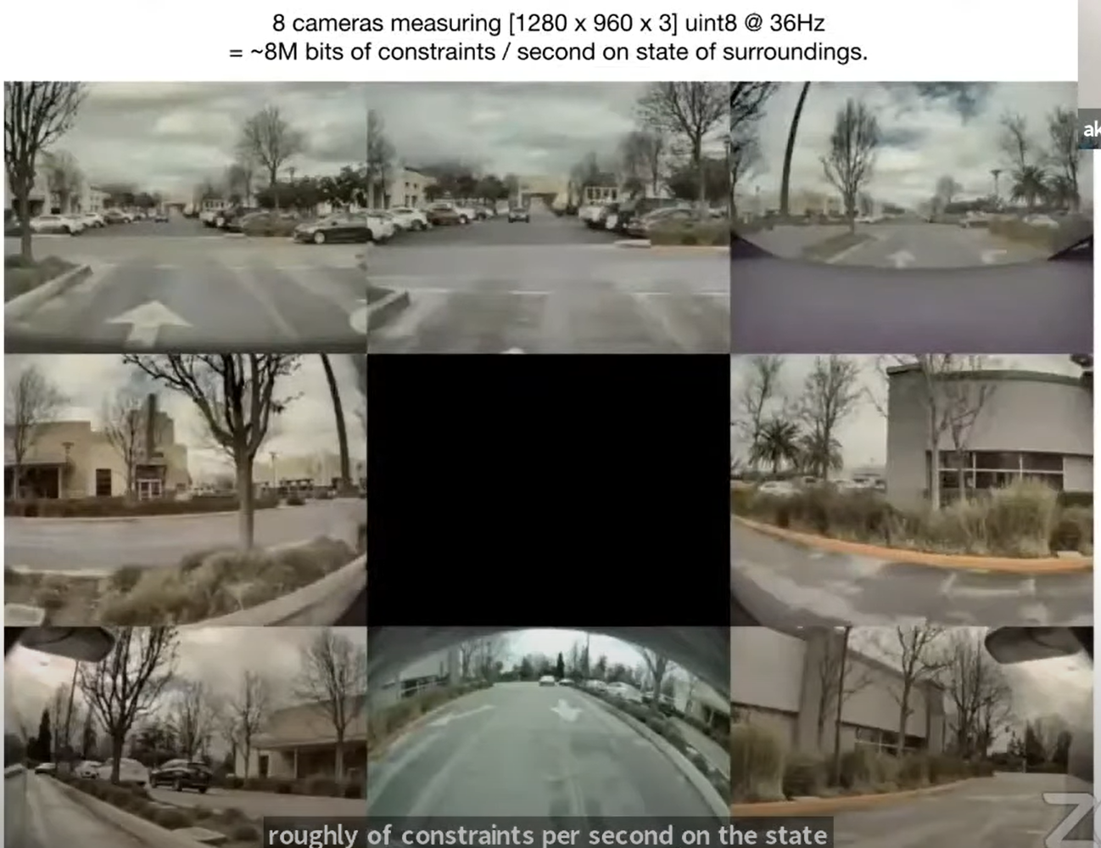
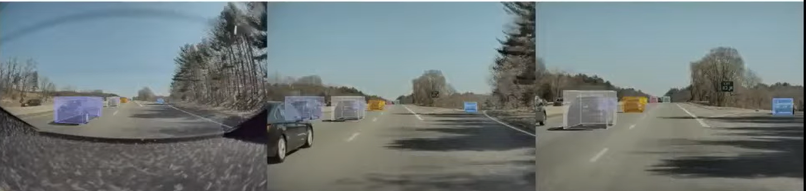
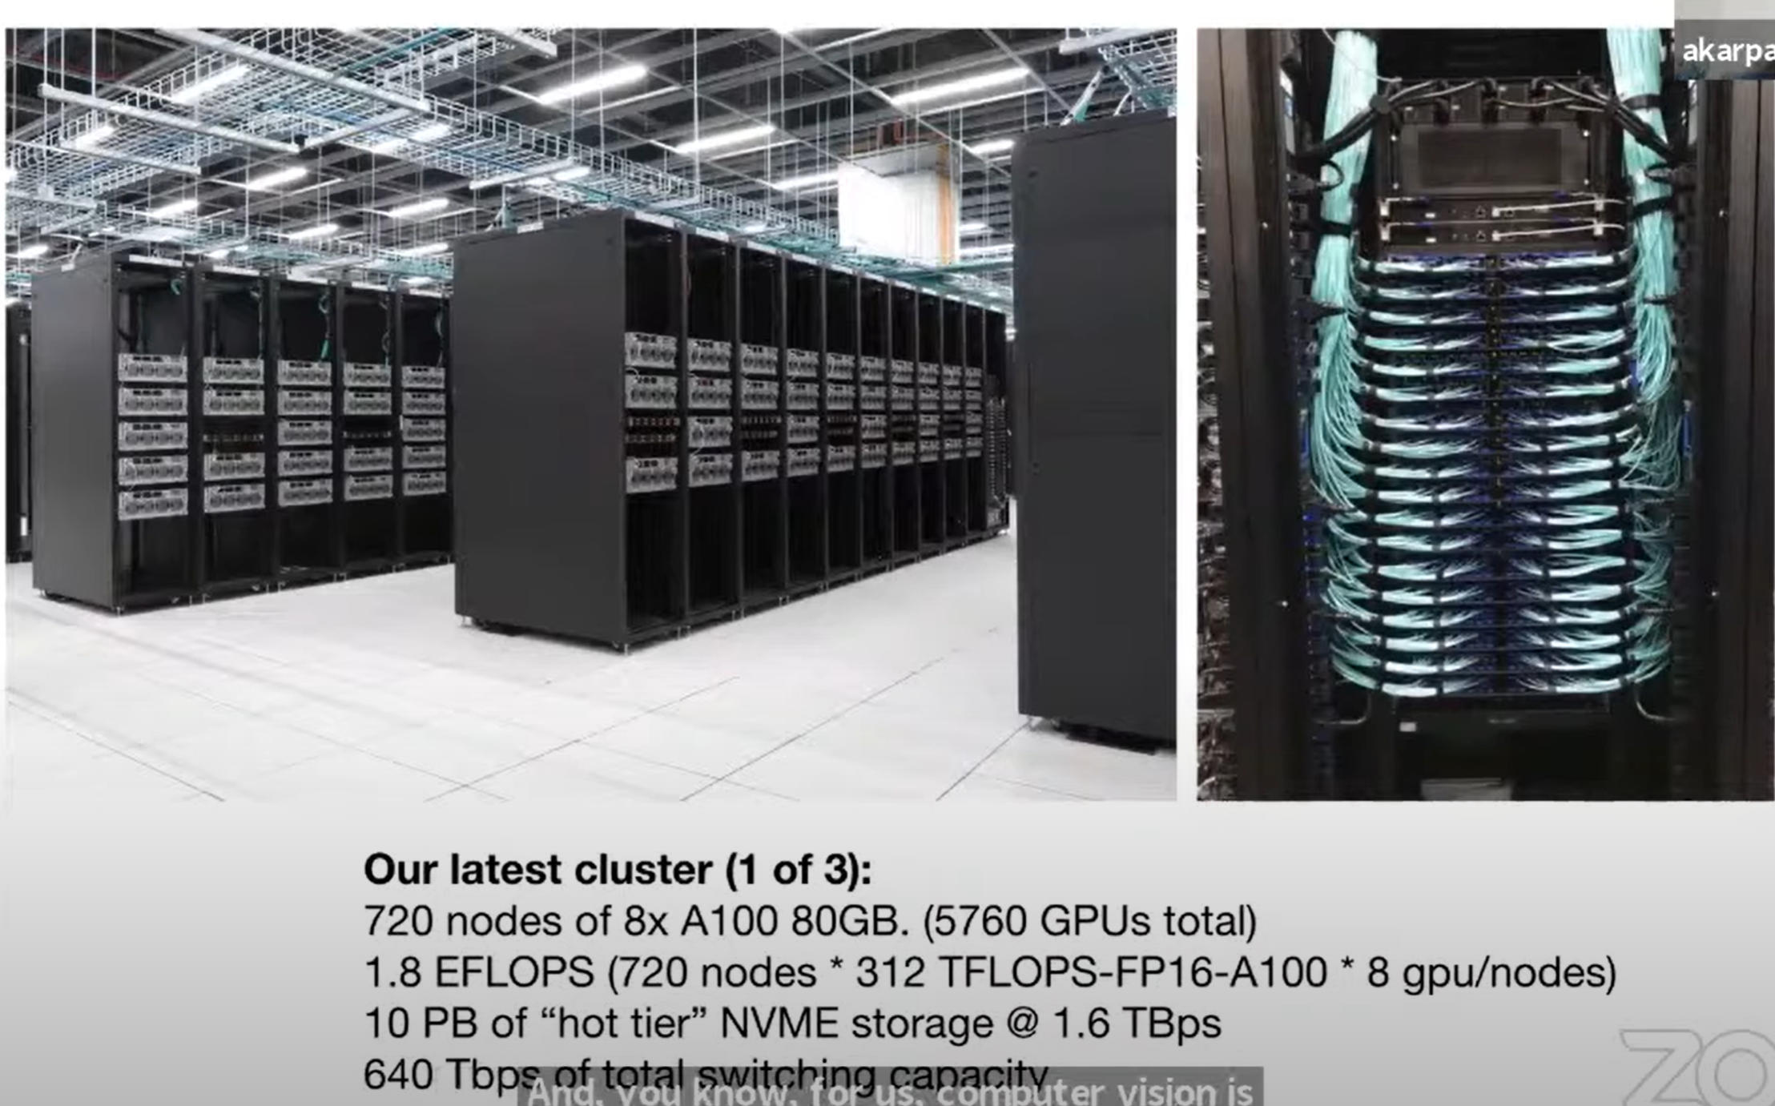
Auto-Labelling at Scale
The guaranteed win is automated generation of clear labels on large and diverse datasets
Require human-in-the-loop
Require system in place
Expensive networks
Human-in-loop
Car speed/velocity/acceleration
Future video frames
Other sensors
on a super-computer
+
3D scene model
Videos from 8 cameras
Auto-labelled 1million 10s videos from 8 cameras → 1e6x10x8x36=2,880 million images
6 billion objects with depth/velocity
7 iterations of retraining/redeployment
in ~4 months
Allow auto-label new objects/events, e.g. fire hydrant, or whether this pedestrian will step off the sidewalk
Impossible if using human labelers
Keynote - Andrej Karpathy, Tesla. https://www.youtube.com/watch?v=g6bOwQdCJrc&t=0s, June 20, 2021

Slide 7
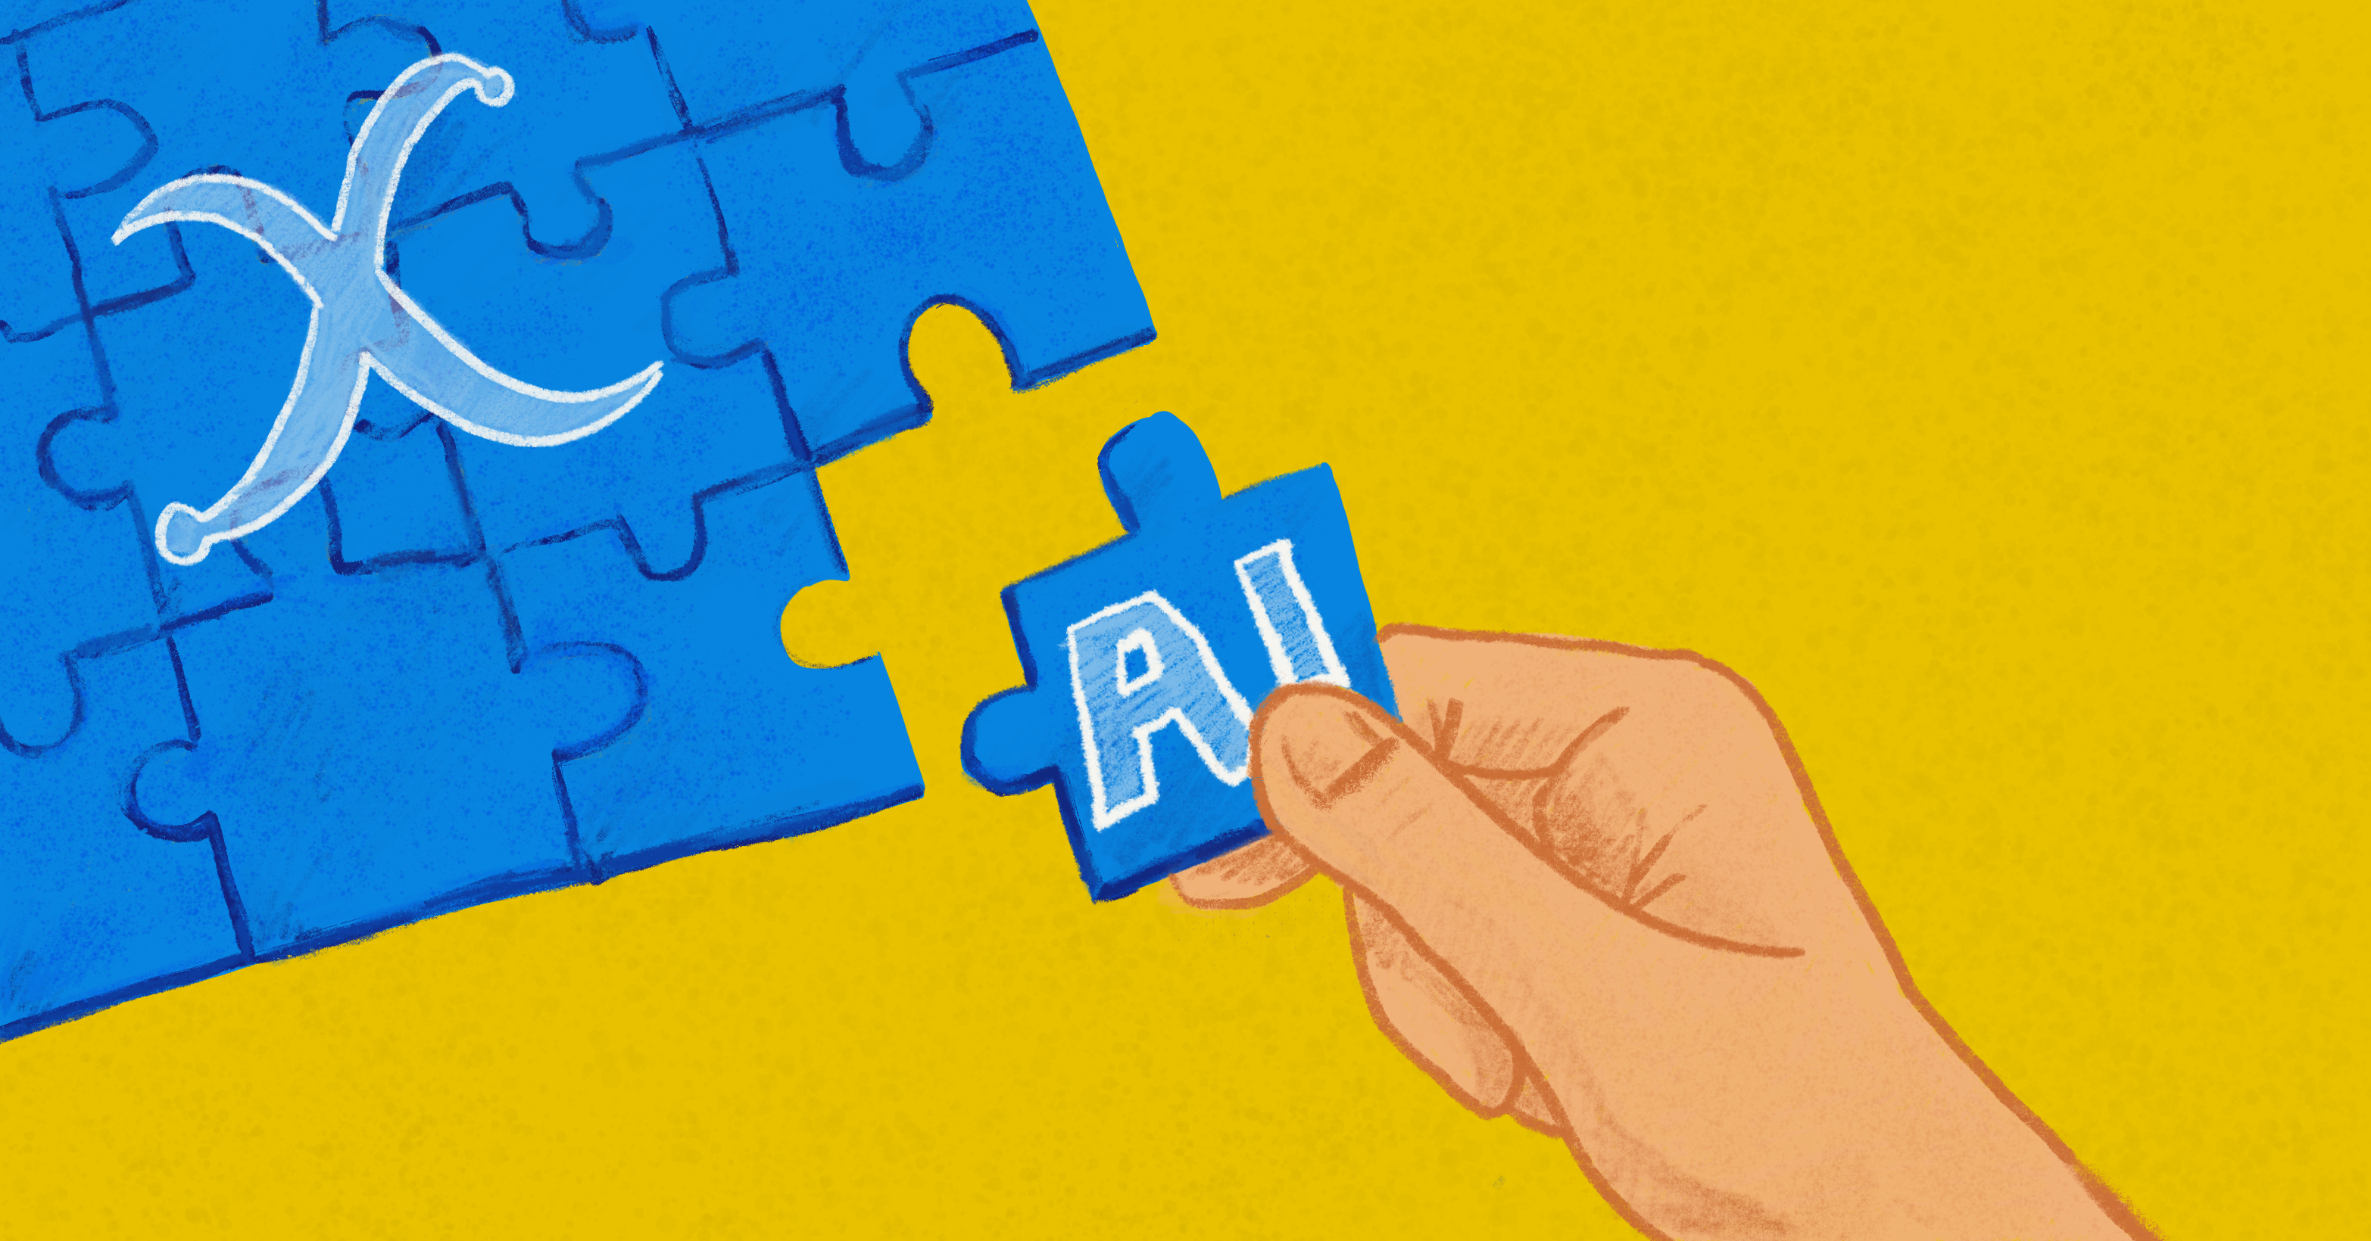
Add DL to your expertise: AI+X
Break-through and create new value!
Domain knowledge
Passion and creativity
DL skills
Data and understanding data
https://medium.datadriveninvestor.com/ai-x-dont-switch-careers-add-ai-34eff21dd3e1

Slide 8
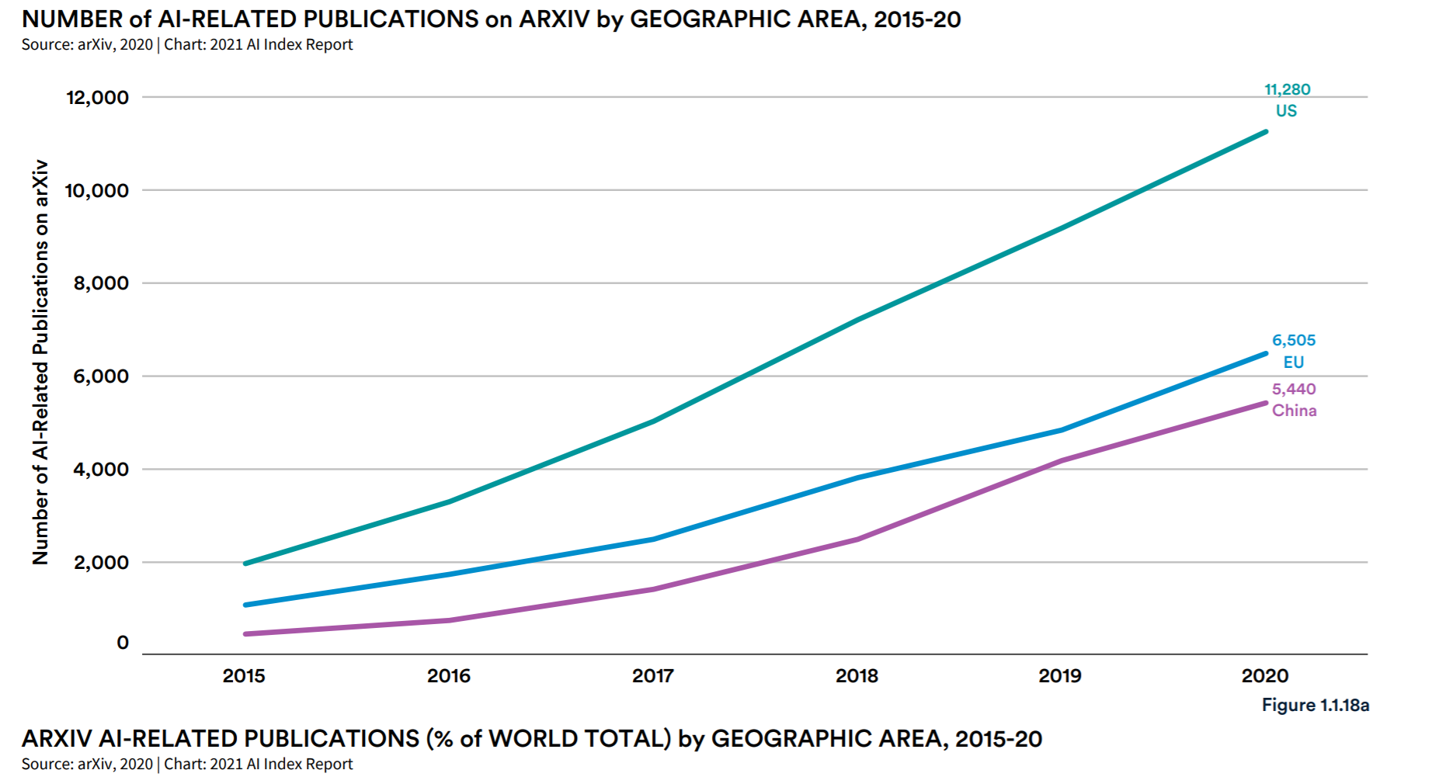
Keep learning

Slide 9
Keep learning : Resources
Tutorial on AI conferences (e.g. ICLR, NeurIPS …)
Your domain journals, find and track AI related papers, focus on how to apply DL to new problems
Kaggle competition, discussion forum, strategy used in winning solutions
Youtube is a good resource: Yannic Kilcher, Two Minutes Paper
AI new letters: Batch by deeplearning.ai, 机器之心，Import AI
Blogs of DeepMind, Google Brain, Fast.AI …
Tutorials: https://medium.com/machine-learning-in-practice/over-200-of-the-best-machine-learning-nlp-and-python-tutorials-2018-edition-dd8cf53cb7dc

Slide 10
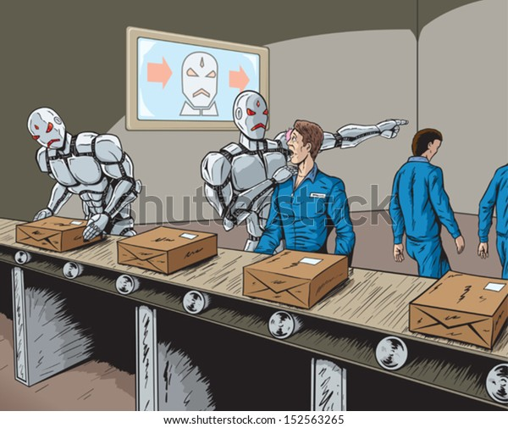
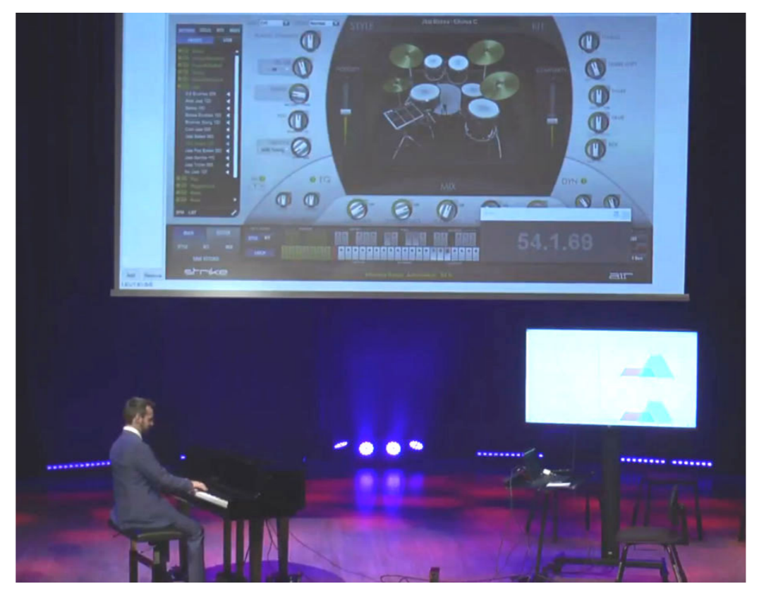
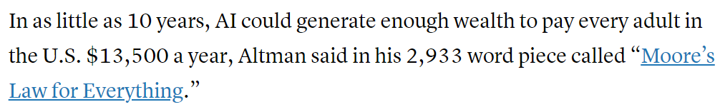
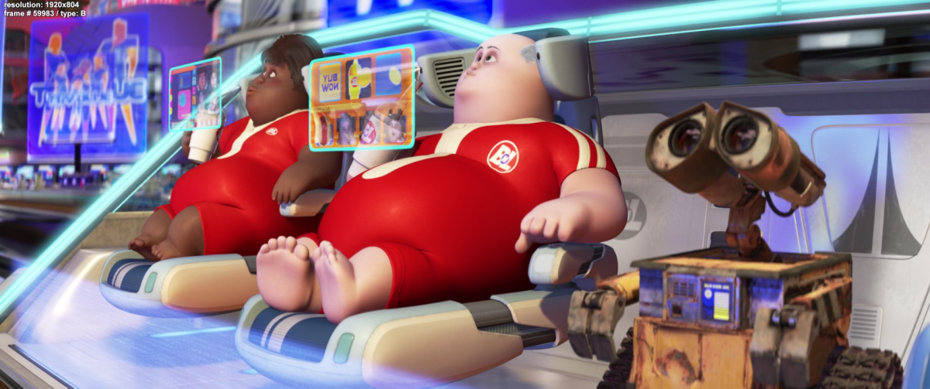
Be optimistic, be sharp
https://moores.samaltman.com/
June 12, 2019, during the international symposium “Humans Meet Artificial Intelligence” - On human-AI collaboration in artistic performance. NeHuAI@ECAI 2020: 38-43
Using the same core technique …

Slide 11

Please fill in the course feedback survey!

